Slide 1

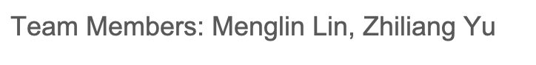
Disney Tour Route Design
–Pathfinding with Graph Data Structure

Slide 2

Contents
·Problem Description
·Methodology
·Result
·Conclusion

Slide 3

Problem Description
When visiting Disneyland, we spend a lot of time design the tour route.
By staring at the map to find the next destination?
We don’t even know whether we can finish all our selected attractions in one day.
So we need to design a program implementing graph to help us find the route
and predict the total tour time.

Slide 4

Methodology - Data Collection
We chose Shanghai Disneyland as our target
We used Shanghai Disneyland App to capture waiting time data and map data
We monitored the waiting time varied through the daytime evey hour
We collected average waiting time from queuetimes.com
Also, we select 26 attractions as vertexes for graph
we design the edge as walking time from one vertex to another

Slide 5
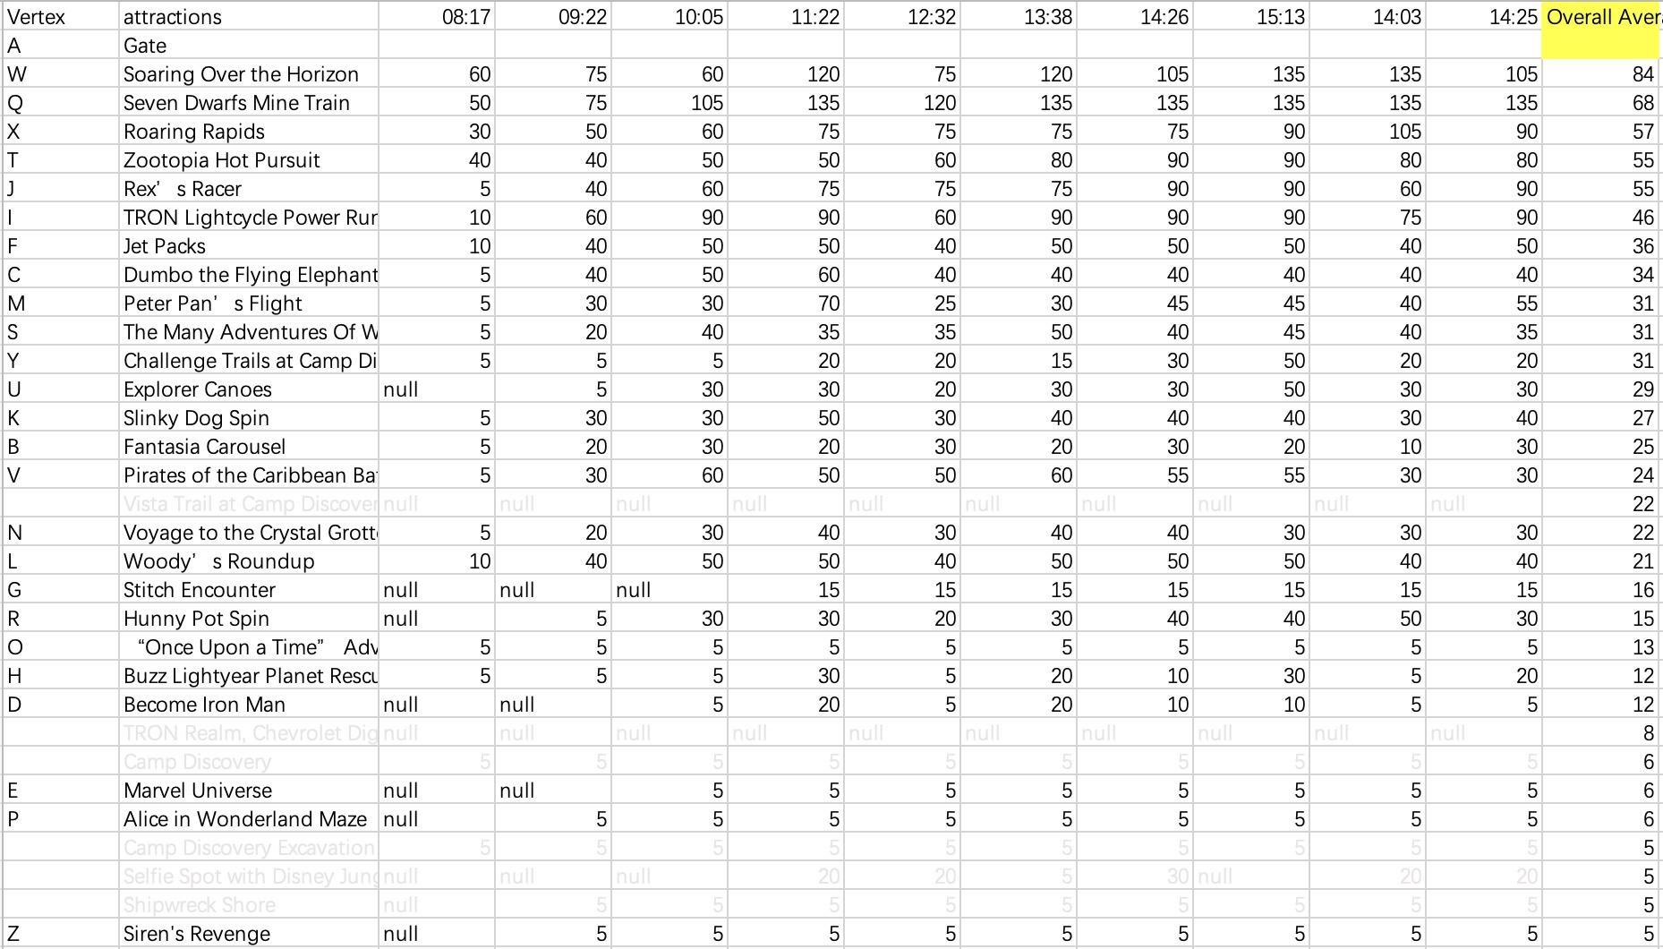
Methodology - Data Collection
Daytime Waiting Time Data Every Hour and Average data:

Slide 6
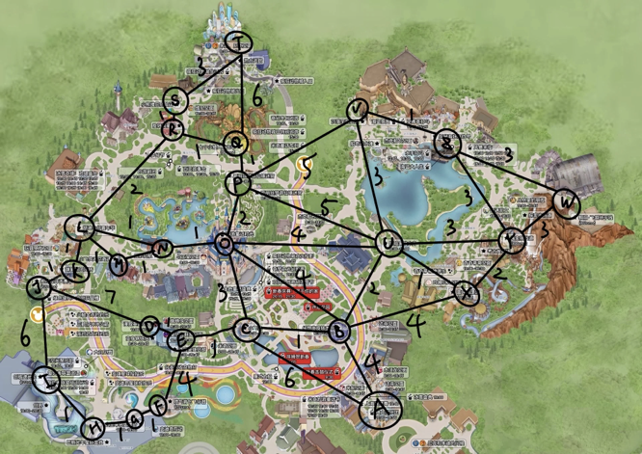
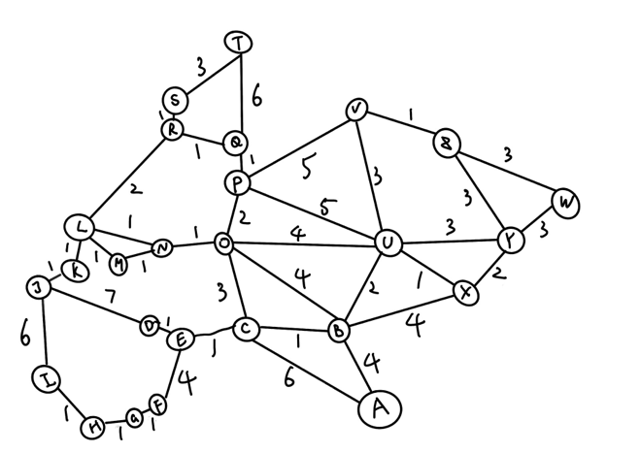
Methodology - Graph Design

Slide 7
Methodology 1: Breadth First Search
We need to set the start point and end point.
Start point is usually the gate of Disneyland.
We use BFS to go through vertexes to end point to see whether all the selected vertexes are located at this route：
·If yes, we will print out the route and total travel time (including waiting time at selected vertex and time to walk through edge.
·If no, we will print out the message that some selected vertexes are missed.

Slide 8
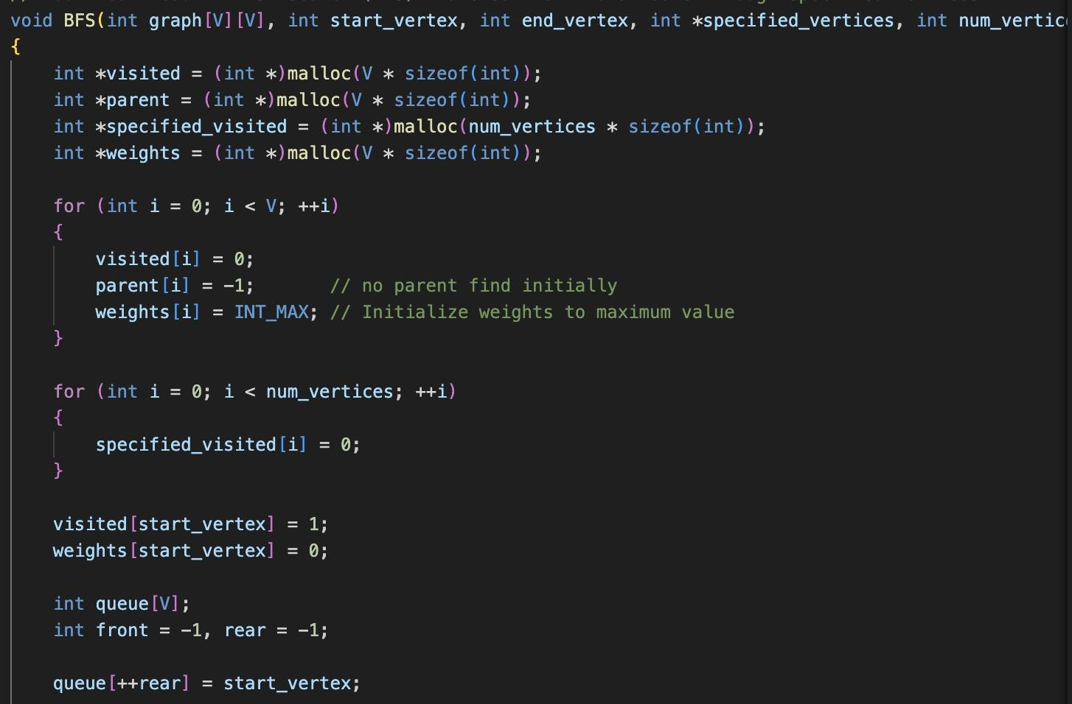
Methodology 1: Breadth First Search
Step 1:
Use BFS to find the route from start point and end point, collecting the data of the route by marking the parent of each vertex.

Slide 9
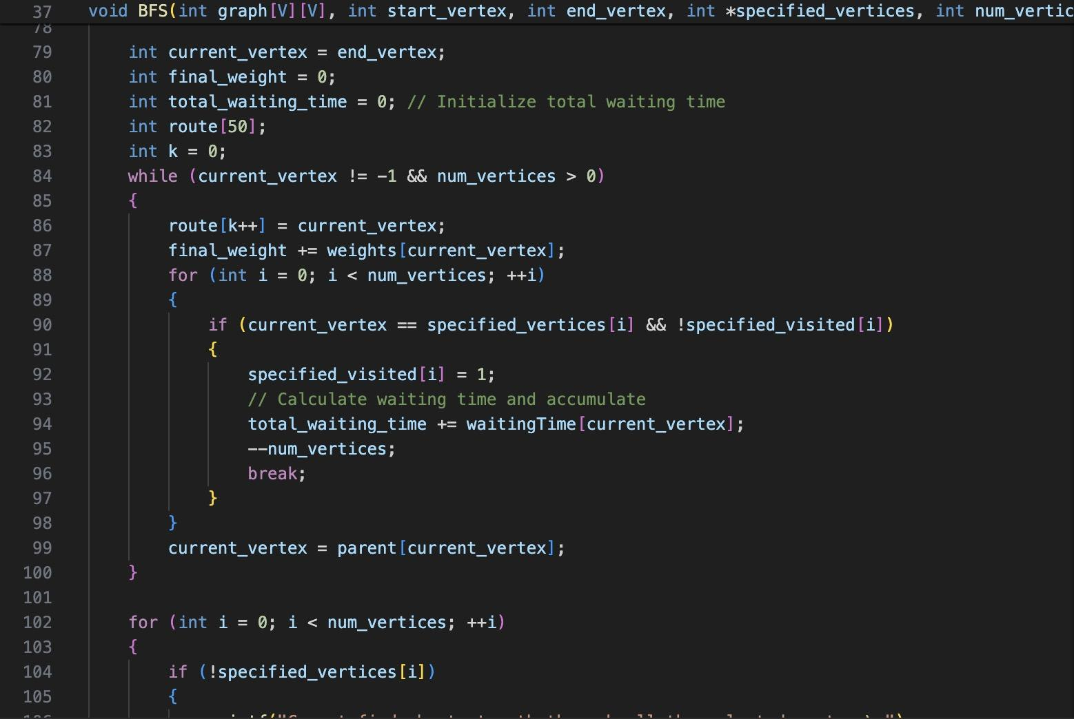
Methodology 1: Breadth First Search
Step 2:
Go through the BFS built route to collect waiting time and weight of edge.
Determining whether all the selected vertexes are passed by.

Slide 10
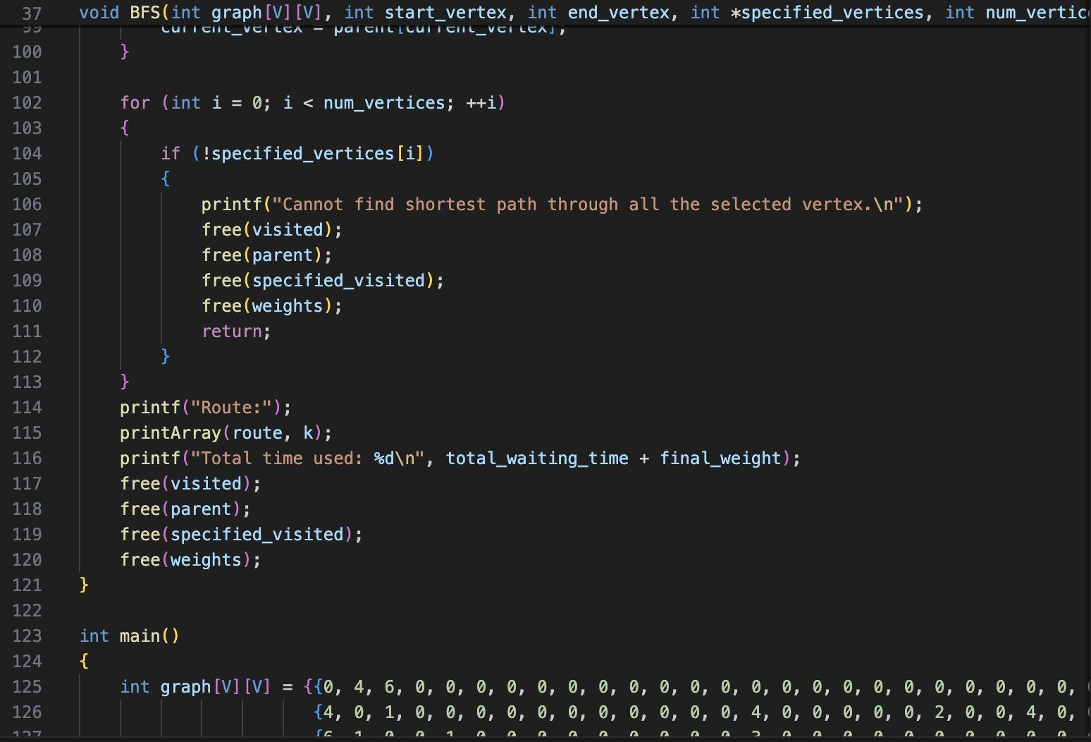
Methodology 1: Breadth First Search
Step 3:
If not: print out message that not all the vertexes are passed
If yes: print out the route and total time used

Slide 11
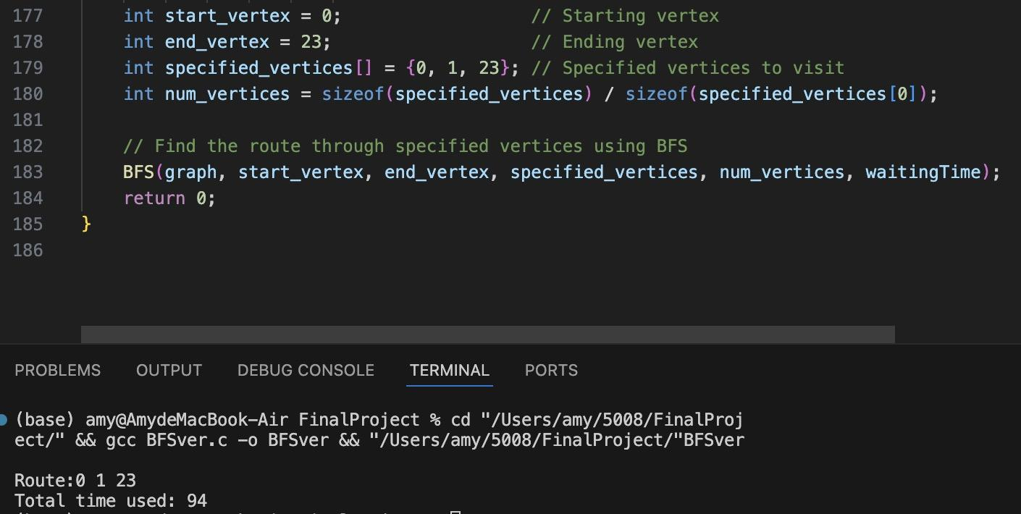
Result 1: Breadth First Search
With choice of shown 3 vertexes, we can easily find the route using BFS.
However, due to the nature of BFS, even if some vertex are seemed to have applicable result, BFS may not build the route as the way we thought.

Slide 12
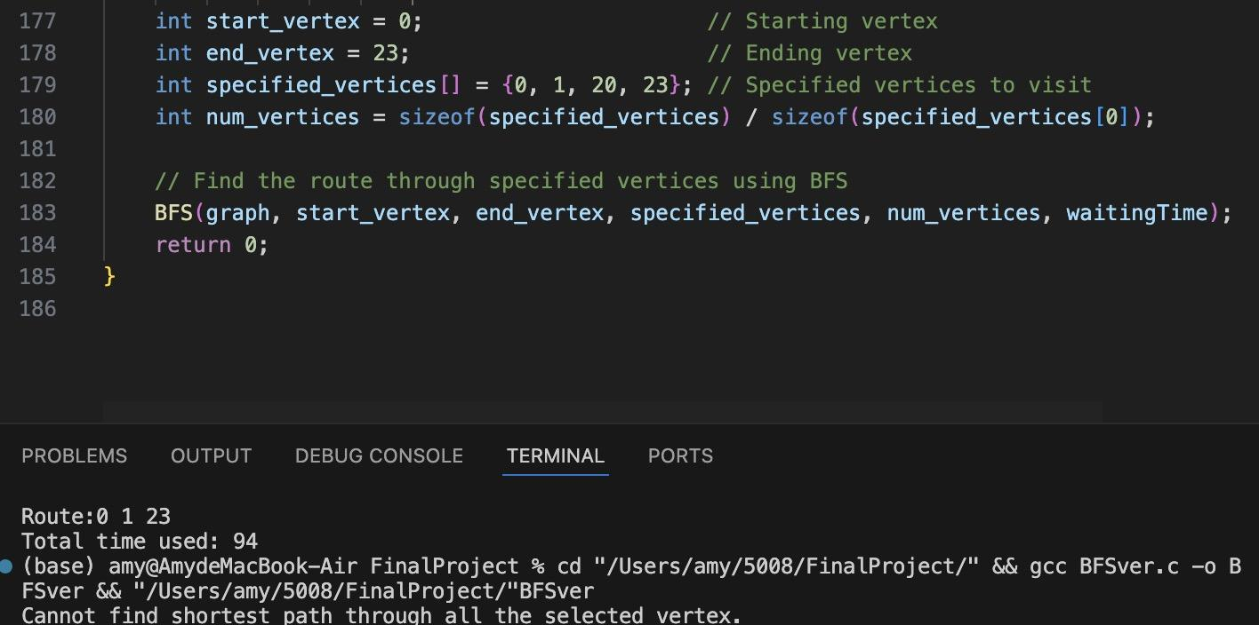
Result 1: Breadth First Search
The searching tree spanned with bread first. Thus, some vertexes may seem to be close but not actually connected in the BFS.
Also, when there are circles in the graph, BFS will ignore the circle since it may lead to infinite loop.
With complex route design, we may not recommend BFS approach.

Slide 13
Methodology 2: Dijkstra’s Algorithm
Since we have some specific points need to go through, and Dijkstra’s algorithm can handle the shortest path from one point to another.
We write a Dijkstra method and keep calling it until the whole path was found.

Slide 14
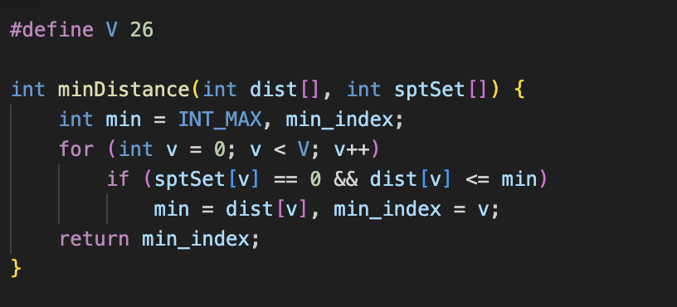
Methodology 2: Dijkstra’s Algorithm
Finding the vertex with the minimum distance from the set of vertices that have not yet been included in the shortest path tree.

Slide 15
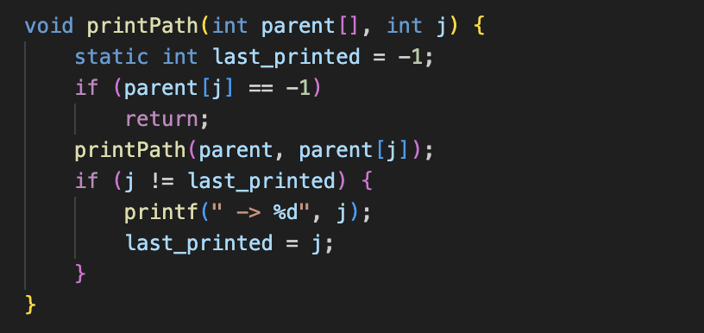
Methodology 2: Dijkstra’s Algorithm
Recursively printing the path from the source vertex to a given destination vertex j using the parent array that records the shortest path tree produced by Dijkstra's algorithm.

Slide 16
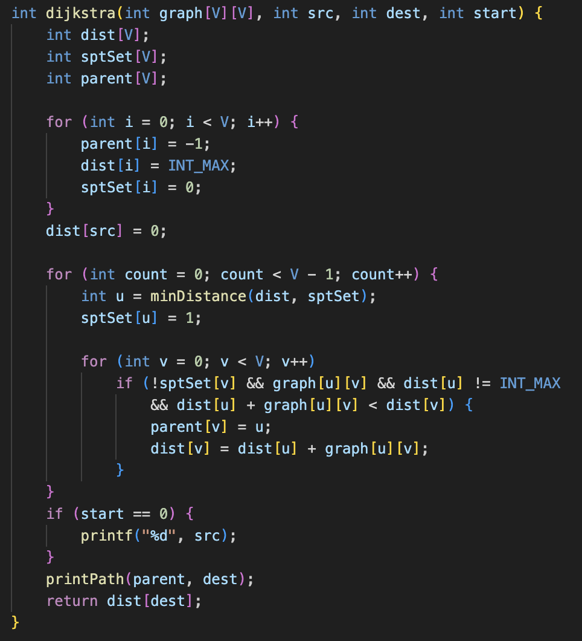
Methodology 2: Dijkstra’s Algorithm
Each iteration selects the vertex ‘u’ not yet included in the SPT with the minimum distance to the source. Then marked it as included.
For each adjacent vertex ‘v’ of ‘u’, if ‘v’ is not yet included in SPT, the edge ‘u-v’ exists, and the path from src to ‘v’ through ‘u’ is shorter than the current known path to ‘v’, it updates the distance of ‘v’ and sets ‘u’ as the parent of ‘v’.
For the convenience of user, we add a start value to make sure the printed path is unrepeated and easy to read.

Slide 17
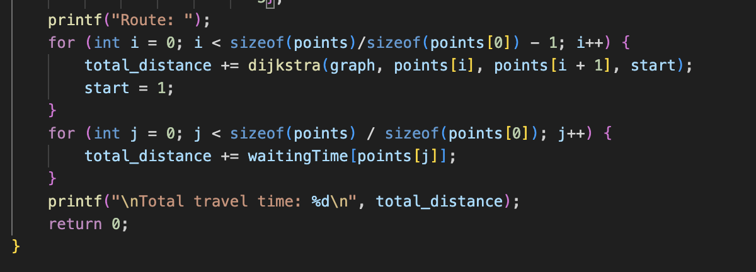
Methodology 2: Dijkstra’s Algorithm
Generate shortest path for each two vertices.
Calculate corresponding waiting time for total travel time.

Slide 18
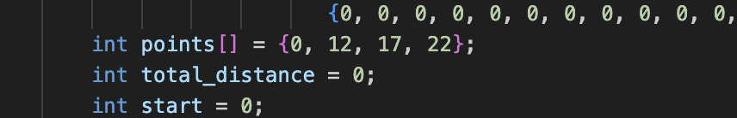

Result 2: Dijkstra’s Algorithm
The Dijkstra's algorithm effectively found the shortest path between each pair of points.
The route taken and the total travel time were displayed.

Slide 19
Conclusion
For calculating the shortest path through Disneyland, Dijkstra's algorithm is the most suitable choice, because it effectively handles graphs with weighted edges.It ensures that the shortest path is found, optimizing the overall visit experience for park guests.
While BFS could find a path, it is only appropriate for scenarios where all edge weights are equal or nonexistent, making it unsuitable for Disneyland's diverse and time-weighted path planning needs.
Additionally, for dynamic waiting time, we recommend update waiting time when necessary and rebuild the route.

Slide 20
Reference
Average waiting time data:https://queue-times.com/en-US/parks/30/stats
Waiting time data: Shanghai Disneyland App
Map data: Shanghai Disneyland App and Baidu Map

Slide 21

Thank You!

